Slide 1
Microbes in Agrobiotechnology

Slide 2
INTRODUCTION
Based on recent advances in genetic engineering, molecular biology. This may revolutionize agriculture, as the green revolution did earlier.
Increase in productivity – lead to environment friendly sustainable agricultural practices.
Direct production of lysine rich wheat, edible vaccines etc.
Others are insect resistant plants, golden rice, edible vaccines, delayed ripening of tomato, lysine rich cereals, herbicide tolerant plants, plant disease resistance etc.
Great concern – safety of GM foods, environmental impact and moral issues.

Slide 3
INTRODUCTION
Challenges in the Post “Green Revolution” era:
Human population increase – land available deterioting and decreasing – water supplies limiting – loss from weeds & insects etc.
Post harvest losses – 10-30%. Demand for food – would double by 2025 and triple by 2050.
Importance of agrobiotechnology – plant biotechnology would solve the crisis and problems faced – also new ways to produce human and animal health care products and industry raw materials.
GE crops in the market. Predominant crops like maize, soybean cotton, potatoes etc.
Studies and field trials of transgenic crops increasing with higher yields, improved quality and enhanced resistance against herbicides, diseases and pests.

Slide 4
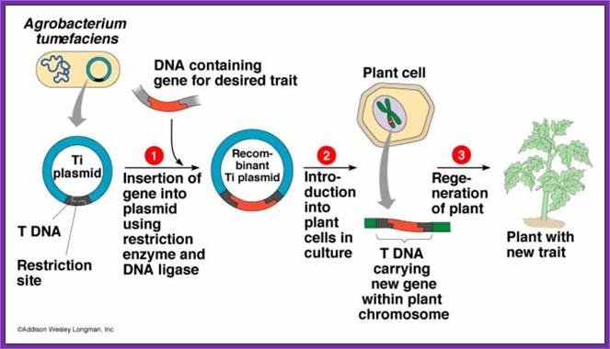
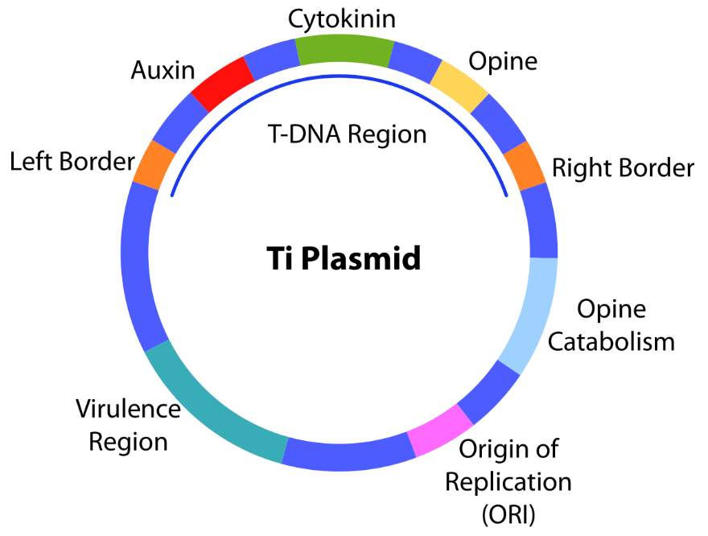
Plant Transformation
Many ways – Agrobacterium, direct uptake of forieign DNA into protoplast, particle bombardment, electroporation etc.
Agrobacterium mediated transformation – widely used – Ti plasmid used.

Slide 5
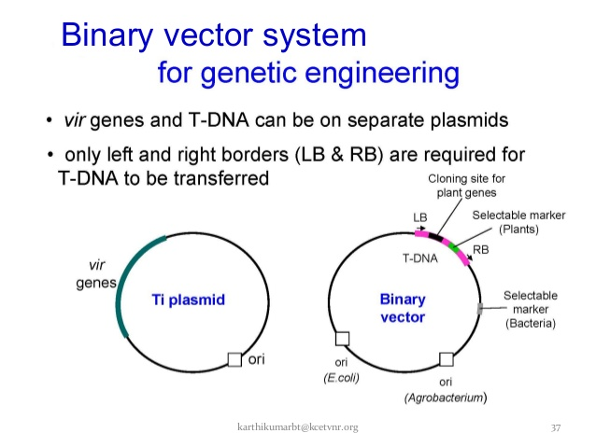

Slide 6
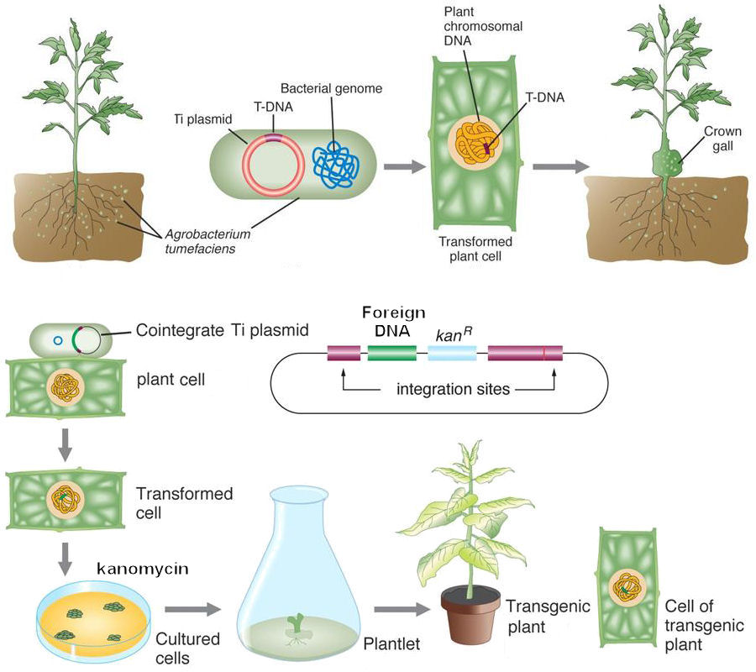

Slide 7
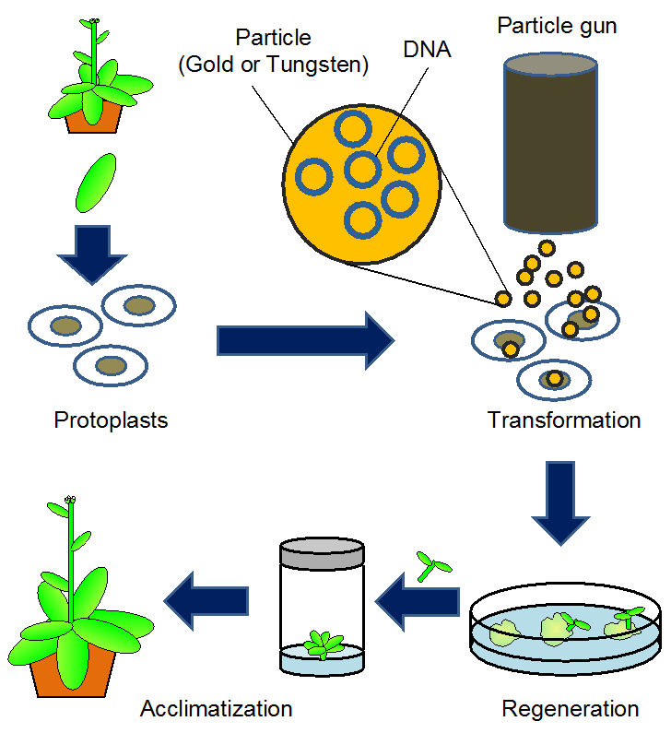
Particle bombardment or biolistics

Slide 8
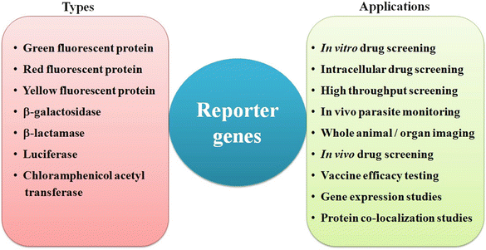

Slide 9
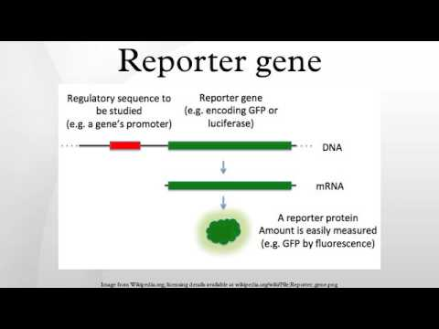

Slide 10
Selectable marker genes
Selectable marker genes are conditionally dominant genes that confer an ability to grow in the presence of applied selective agents that are normally toxic to plant cells or inhibitory to plant growth, such as antibiotics and herbicides.
A selectable marker helps to identify and delete non-transformants and allows processors to expand selectively. A selectable marker is a gene inserted into a cell, in particular a bacterium or a cultured cell, which confers a trait appropriate for artificial selection.
Genes that are frequently used to select transformed plant tissues include nptII, hpt, bar, and gox, that confer resistance to kanamycin, hygromycin, phosphinothricin, and glyphosate, respectively.
Commonly used selectable marker systems include neomycin phosphotransferase, hygromycin phosphotransferase, phosphoinothricin acetyltransferase, and glyphosate oxidoreductase.
Hygromycin B has been used as a more favorable selective agent than kanamycin for transformation of a number of crop species including peanuts and soybean, in a somatic embryogenesis regeneration system

Slide 11
Promoters & Gene expression
Promoter. A promoter is a sequence of DNA needed to turn a gene on or off. The process of transcription is initiated at the promoter. Usually found near the beginning of a gene, the promoter has a binding site for the enzyme used to make a messenger RNA (mRNA) molecule.
The Promoter and the Transcription Machinery. Genes are organized to make the control of gene expression easier. ... The purpose of the promoter is to bind transcription factors that control the initiation of transcription. Within the promoter region, just upstream of the transcriptional start site, resides the TATA box.
CaMV 35S is the most commonly used constitutive promoter for high levels of gene expression in dicot plants. Maize Ubi and rice Act-1 are the currently the most commonly used constitutive promoters for monocots.

Slide 12
Promoters & Gene expression
Chemically inducible promoters Tetracycline and its derivatives serve as inducing agents to allow promoter activation. One of the most commonly used prokaryotic promoters is the negative inducible pLac promoter. This promoter requires removal of the lac repressor (lacI protein) for transcription to be activated.
Tissue specific promoters
A promoter whose activity is observed only in specific tissues of the plant is known as a tissue-specific promoter. Such promoters express the cistronic part of their gene in cells of particular tissue types, and their expression may also be induced in those tissues by internal or external factors.

Slide 13
Examples:
Golden Rice
Insect resistant plants
Edible vaccines
Delayed ripening in tomato
Lysine rich cereals
Herbicide tolerant plants
Plant disease resistance

